Slide 1
Data Mining:
Concepts and Techniques
— Chapter 1 —
— Introduction —
Data Mining: Concepts and Techniques

Slide 2
Chapter 1. Introduction
Motivation: Why data mining?
What is data mining?
Data Mining: On what kind of data?
Data mining functionality
Are all the patterns interesting?
Classification of data mining systems
Data Mining Task Primitives
Integration of data mining system with a DB and DW System
Major issues in data mining
Data Mining: Concepts and Techniques

Slide 3
Why Data Mining?
The wide availability of huge amounts of data and the imminent need for turning such data into useful information and knowledge which can be used for applications ranging from business management, production control, and market analysis to engineering design and science exploration..
The Explosive Growth of Data: from terabytes to petabytes
  Data collection and data availability
    Automated data collection tools, database systems, Web, computerized society
  Major sources of abundant data
    Business: Web, e-commerce, transactions, stocks, …
    Science: Remote sensing, bioinformatics, scientific simulation, …
    Society and everyone: news, digital cameras, …
We are drowning in data, but starving for knowledge!
Data mining—Automated analysis of massive data sets
Data Mining: Concepts and Techniques

Slide 4
Evolution of Database Technology
1960s: Data collection, database creation:
  Primitive file Processing
1970s: Database Management Systems:
  Relational data model, relational DBMS implementation
    IMS (Information Management System is a joint hierarchical database and information management system with extensive transaction processing capabilities.) and network DBMS
1980s: Advanced Database Systems :
  RDBMS, advanced data models (extended-relational, OO, deductive, etc.)
  Application-oriented DBMS (spatial, scientific, engineering, etc.)
1990s: Advanced Data Analysis :
  Data mining, data warehousing, multimedia databases, and Web databases
2000s: Web based databases
  Stream data management and mining
  Data mining and its applications
  Web technology (XML, data integration) and global information systems
Data Mining: Concepts and Techniques

Slide 5


What Is Data Mining?
Data mining (knowledge discovery from data)
  Extraction of interesting (non-trivial, implicit, previously unknown and potentially useful) patterns or knowledge from huge amount of data
Alternative names
  Knowledge discovery (mining) in databases (KDD), knowledge extraction, data/pattern analysis, data archeology, data dredging, information harvesting, business intelligence, etc.
Watch out: Is everything “data mining”?
  Simple search and query processing
  (Deductive) expert systems
Data Mining: Concepts and Techniques

Slide 6
Why Data Mining?—Potential Applications
Data analysis and decision support
  Market analysis and management
    Target marketing, customer relationship management (CRM), market basket analysis, cross selling, market segmentation
  Risk analysis and management
    Forecasting, customer retention, improved underwriting, quality control, competitive analysis
  Fraud detection and detection of unusual patterns (outliers)
Other Applications
  Text mining (news group, email, documents) and Web mining
  Stream data mining
  Bioinformatics and bio-data analysis
Data Mining: Concepts and Techniques

Slide 7
Ex. 1: Market Analysis and Management
Where does the data come from?—Credit card transactions, loyalty cards, discount coupons, customer complaint calls, plus (public) lifestyle studies
Target marketing
  Find clusters of “model” customers who share the same characteristics: interest, income level, spending habits, etc.,
  Determine customer purchasing patterns over time
Cross-market analysis—Find associations/co-relations between product sales, & predict based on such association
Customer profiling—What types of customers buy what products (clustering or classification)
Customer requirement analysis
  Identify the best products for different customers
  Predict what factors will attract new customers
Provision of summary information
  Multidimensional summary reports
  Statistical summary information (data central tendency and variation)
Data Mining: Concepts and Techniques

Slide 8
Ex. 2: Corporate Analysis & Risk Management
Finance planning and asset evaluation
  cash flow analysis and prediction
  contingent claim analysis to evaluate assets
  cross-sectional and time series analysis (financial-ratio, trend analysis, etc.)
Resource planning
  summarize and compare the resources and spending
Competition
  monitor competitors and market directions
  group customers into classes and a class-based pricing procedure
  set pricing strategy in a highly competitive market
Data Mining: Concepts and Techniques

Slide 9
Ex. 3: Fraud Detection & Mining Unusual Patterns
Approaches: Clustering & model construction for frauds, outlier analysis
Applications: Health care, retail, credit card service, telecomm.
  Auto insurance: ring of collisions
  Money laundering: suspicious monetary transactions
  Medical insurance
    Professional patients, ring of doctors, and ring of references
    Unnecessary or correlated screening tests
  Telecommunications: phone-call fraud
    Phone call model: destination of the call, duration, time of day or week. Analyze patterns that deviate from an expected norm
  Retail industry
    Analysts estimate that 38% of retail shrink is due to dishonest employees
  Anti-terrorism
Data Mining: Concepts and Techniques

Slide 10
Knowledge Discovery (KDD) Process
Knowledge
  Data mining—core of knowledge discovery process
Pattern Evaluation & presentation
Data Mining
Patterns
Task-relevant Data
Data Warehouse
Selection & Transformation
Data Cleaning
Data Integration
Databases
Data Mining: Concepts and Techniques

Slide 11
KDD Process: Several Key Steps
Learning the application domain
  relevant prior knowledge and goals of application
Creating a target data set: data selection
Data cleaning: to remove noise and inconsistent data
Data integration: multiple data sources may be combined
Data selection: data relevant to analysis task are retrieved from db
Data reduction and transformation: data are transformed or consolidated into forms appropriate for mining.
  Find useful features, dimensionality/variable reduction, invariant representation
Choosing functions of data mining
  summarization, classification, regression, association, clustering
Choosing the mining algorithm(s)
Data mining: intelligent methods are applied to extract patterns of interest
Pattern evaluation and knowledge presentation
  visualization, transformation, removing redundant patterns, etc. to present mined knowledge
Use of discovered knowledge
Data Mining: Concepts and Techniques

Slide 12
Data Warehouse V/S Database
A data warehouse is a repository of information collected from multiple sources, over a history of time, stored under a unified schema, and used for data analysis and decision support;
whereas a database, is a collection of interrelated data that represents the current status of the stored data.
There could be multiple heterogeneous databases where the schema of one database may not agree with the schema of another.
A database system supports ad-hoc query and on-line transaction processing.
Both are repositories of information, storing huge amounts of persistent data.
Data Mining: Concepts and Techniques

Slide 13
Architecture: Typical Data Mining System
Data mining is the process of discovering interesting knowledge from large amounts of data stored either in databases, data warehouses, or other information repository
Graphical User Interface
Pattern Evaluation
Knowledge-Base
Data Mining Engine
Database or Data Warehouse Server
data cleaning, integration, and selection
Data
Warehouse
World-Wide
Web
Other Info
Repositories
Database
Data Mining: Concepts and Techniques

Slide 14
Major Data Mining System Components
A database, data warehouse, or other information repository, which consists of the set of databases, data warehouses, spreadsheets, or other kinds of information repositories.
A database or data warehouse server which fetches the relevant data based on users’ data mining requests.
A knowledge base contains the domain knowledge used to guide the search or to evaluate the interestingness of resulting patterns. For example, the knowledge base may contain metadata which describes data from multiple heterogeneous sources.
A data mining engine, which consists of a set of functional modules for tasks such as characterization, association, classification, cluster analysis, and evolution and deviation analysis.
A pattern evaluation module that works in tandem with the data mining modules by employing interestingness measures to help focus the search towards interestingness patterns.
A graphical user interface that allows the user an interactive approach to the data mining system.
Data Mining: Concepts and Techniques

Slide 15
Data Mining and Business Intelligence
Increasing potential
to support
business decisions
End User
Decision Making
Data Presentation
Business
Analyst
Visualization Techniques
Data Mining
Data
Analyst
Information Discovery
Data Exploration
Statistical Summary, Querying, and Reporting
Data Preprocessing/Integration, Data Warehouses
Data Sources
DBA
Paper, Files, Web documents, Scientific experiments, Database Systems
Data Mining: Concepts and Techniques

Slide 16
Data Mining: On What Kinds of Data?
Data mining is applicable to any kind of information repository as....
Flat files- most common data source for data mining algorithms, at the research level. Flat files are simple data files in text or binary format. The data in these files can be transactions, time-series data, scientific measurements, etc.
Database-oriented data sets and applications
  Relational database- consists of a set of tables containing either values of entity attributes, or values of attributes from entity relationships. Data mining can benefit from SQL for data selection, transformation and consolidation, it goes beyond what SQL provides, such as predicting, comparing, detecting deviations, etc.
  Data warehouse- is a repository of information collected from multiple sources, stored under a unified schema, usually resides at a single site. They warehouses are constructed via a process of data cleansing, data transformation, data integration, data loading, and periodic data refreshing.
Data sources
(diff. locations)
clean, transform, integrate, load
Data Warehouse
Query & Analysis tools
Clients
Data Mining: Concepts and Techniques

Slide 17
Data Mining: On What Kinds of Data?
  Transactional database- consists of a flat file where each record represents a transaction. A transaction typically includes a unique transaction identity number (trans ID), and a list of the items making up the transaction (such as items purchased in a store)
Advanced data sets and advanced applications
  Object-relational databases- is designed based on the object-oriented programming paradigm where data are a large number of objects organized into classes and class hierarchies. Each entity in the database is considered as an object. The object contains a set of variables that describe the object, a set of messages that the object can use to communicate with other objects or with the rest of the database system and a set of methods where each method holds the code to implement a message.
  Time-series data, temporal data, sequence data (incl. bio-sequences)-Time-series databases contain time related data such stock market data or logged activities. Sequence data stores sequences of ordered events like web click streams. Data mining in such databases commonly includes the study of trends and correlations between evolutions of different variables, as well as the prediction of trends and movements of the variables in time.
Data Mining: Concepts and Techniques

Slide 18
Data Mining: On What Kinds of Data?
  Spatial data and spatiotemporal data- contains spatial-related information, which may be represented in the form of raster or vector data. Raster data consists of n-dimensional bit maps or pixel maps, and vector data are represented by lines, points, polygons or other kinds of processed primitives, Some examples of spatial databases include geographical (map) databases, VLSI chip designs, and medical and satellite images databases.
  Text databases & Multimedia database- Text database contains text documents or other word descriptions in the form of long sentences or paragraphs, such as product specifications, error or bug reports, warning messages, summary reports, notes, or other documents. Multimedia database stores images, audio, and video data, and is used in applications such as picture content-based retrieval, voice-mail systems, video-on-demand systems, the World Wide Web, and speech-based user interfaces.
  Heterogeneous databases and legacy databases- Heterogeneous database consists of a set of interconnected, autonomous component databases. Legacy database is a group of heterogeneous databases that combines different kinds of data systems.
Data Mining: Concepts and Techniques

Slide 19
Data Mining: On What Kinds of Data?
  Data streams and sensor data- have unique features like huge (infinite) volume, dynamically changing, flowing in and out in a fixed order, demanding very fast response time. Examples include scientific and engineering data, time-series data, network traffic, stock exchange, telecommunication, web click streams, video surveillance, weather or environment monitoring.
  The World-Wide Web- provides rich, world-wide, on-line information services, where data objects are linked together to facilitate interactive access. Some examples of distributed information services associated with the World-Wide Web include America Online, Yahoo!, AltaVista, and Prodigy.
  Structure data, graphs, social networks and multi-linked data
Data Mining: Concepts and Techniques

Slide 20
Data mining functionalities: what kinds of patterns can be mined?
Data mining functionalities are used to specify the kind of patterns to be found in data mining tasks. In general, data mining tasks can be classified into two categories:
  Descriptive- Descriptive mining tasks characterize the general properties of the data in the database.
  Predictive- mining tasks perform inference on the current data in order to make predictions.
  Data Mining
  Predictive Descriptive
Classifi- Regre- Time Prediction Clustering Summari- Assicia-
cation ssion Series zation tion
Analysis
Data Mining: Concepts and Techniques

Slide 21
Data Mining Functionalities
Concept description: Characterization and discrimination
  It describes a given set of data in a concise and summarative manner, presenting interesting general properties of the data. These descriptions can be derived via
  1. data characterization, by summarizing the data of the class under study (often called the target class)
  2. data discrimination, by comparison of the target class with one or a set of comparative classes
  3. both data characterization and discrimination
  Generalize, summarize, and contrast data characteristics, e.g., dry vs. wet regions
  Discrimination descriptions expressed in rule form are referred to as discriminant rules.
Data Mining: Concepts and Techniques

Slide 22
Data Mining Functionalities
Frequent patterns, association, correlation vs. causality
  Frequent patterns- occur frequently in data. Kinds of frequent patterns are:
    Itemsets (items frequently appear together like bread butter)
    Subsequences (frequent sequential pattern in transaction like 1st purchase PC followed by digicam and then memory card)
    Substructures (frequent structured pattern in graph, tree or lattice)
  Association- It is the discovery of association rules showing attribute-value conditions that occur frequently together in a given set of data.
    major(X, “computing science””) ⇒ owns(X, “personal computer”)
    [support = 12%, confidence = 98%]
    X is a variable representing a student. The rule indicates that of the students under study, 12% (support) major in computing science and own a personal computer. There is a 98% probability (confidence, or certainty) that a student in this group owns a personal computer.
Data Mining: Concepts and Techniques

Slide 23
Data Mining Functionalities
  Correlation analysis- is a technique use to measure the association between two variables. A correlation coefficient (r) is a statistic used for measuring the strength of a supposed linear association between two variables. Correlations range from -1.0 to +1.0 in value.
    A correlation coefficient of 1.0 indicates a perfect positive relationship.
    A correlation coefficient of 0.0 indicates no relationship between the two variables.
    A correlation coefficient of -1.0 indicates a perfect negative relationship.
  Mining frequent patterns leads to discovery of interesting associations and correlations within data
Data Mining: Concepts and Techniques

Slide 24
Data Mining Functionalities
  Classification and prediction- Construct models (functions) that describe and distinguish classes or concepts for future prediction
  Classification- can be defined as the process of finding a model (or function) that describes and distinguishes data classes or concepts, for the purpose of being able to use the model to predict the class of objects whose class label is unknown. The derived model is based on the analysis of a set of training data (i.e., data objects whose class label is known).
    It predicts categorical class labels
    It classifies data (constructs a model) based on the training set and the values (class labels) in a classifying attribute and uses it in classifying new data
    Typical Applications
      Credit approval
      Target marketing
      Medical diagnosis
      Treatment effectiveness analysis
Data Mining: Concepts and Techniques

Slide 25
Data Mining Functionalities
  A classification model can be represented in various forms, such as
    1) IF-THEN rules,
    student ( class , "undergraduate") AND concentration ( level, "high") ==> class A
    student (class ,"undergraduate") AND concentrtion (level,"low") ==> class B
    student (class , "post graduate") ==> class C
    2) Decision tree
  yes no
  high low
    3) Neural network- is a collection of neuron like processing units with weighted connections between the units.
  Prediction: Find some missing or unavailable data values rather than class labels. Prediction also encompasses the identification of distribution trends based on the available data.
    E.g., classify countries based on (climate), or classify cars based on (gas mileage)
Undergraduate
Concentration level
Class C
Class A
Class B
Data Mining: Concepts and Techniques

Slide 26
Data Mining Functionalities
Classification
Prediction
is to construct a set ofmodels (or functions) that describe and distinguish data class or concepts
is to predict some missing or unavailable, and often numerical, data values.
    Classification and Prediction are both tools for prediction:
      Classification is used for predicting the class label of data objects
      prediction is typically used for predicting missing numerical data values.
Data Mining: Concepts and Techniques

Slide 27
Data Mining Functionalities
Cluster analysis
  Clustering analyzes data objects without consulting a known class label.
  Class label is unknown: Group data to form new classes, e.g., cluster houses to find distribution patterns
  The objects are clustered or grouped based on the principle of maximizing the intraclass similarity and minimizing the interclass similarity.
  Each cluster that is formed can be viewed as a class of objects.
  Clustering can also facilitate taxonomy formation, that is, the organization of observations into a hierarchy of classes that group similar events together.
Classification vs. Clustering
  in classification we have a set of predefined classes and want to know which class a new object belongs to.
  Clustering tries to group a set of objects and find whether there is some relationship between the objects.
  In the context of machine learning, classification is supervised learning and clustering is unsupervised learning.
Data Mining: Concepts and Techniques

Slide 28
Data Mining Functionalities
Outlier analysis
  Outlier: Data object that does not comply with the general behavior of the data
  The data objects which do not fall within the cluster will be called as outlier data objects. Noisy data or exceptional data are also called as outlier data.
  The analysis of outlier data is referred to as outlier mining.
  Noise or exception? Useful in fraud detection, rare events analysis
Trend and evolution analysis- describes and models regularities or trends for objects whose behavior changes over time.
  Example: The data of result of the last several years of a college would give an idea of quality of graduated produced by it
Trend and deviation: e.g., regression analysis
Sequential pattern mining: e.g., digital camera → large SD memory
Periodicity analysis
Similarity-based analysis
Other pattern-directed or statistical analyses
Data Mining: Concepts and Techniques

Slide 29
Data Mining: Confluence of Multiple Disciplines
Database
Technology
Statistics
Machine
Learning
Data Mining
Visualization
Pattern
Recognition
Other
Disciplines
Information Science
Data Mining: Concepts and Techniques

Slide 30
Data Mining: Confluence of Multiple Disciplines
Data Mining is an interdisciplinary field, the confluence of a set of disciplines.
Data mining systems can be categorized according to various criteria as:
  Classification according to the type of data source mined: it categorizes data mining systems according to the type of data handled such as spatial data, multimedia data, time-series data, text data, World Wide Web, etc.
  Classification according to the data model drawn on: it categorizes data mining systems based on the data model involved such as relational database, object-oriented database, data warehouse, transactional, etc.
  Classification according to the king of knowledge discovered: it categorizes data mining systems based on the kind of knowledge discovered or data mining functionalities, such as characterization, discrimination, association, classification, clustering, etc.
  Classification according to mining techniques used: it categorizes data mining systems according to the data analysis approach used such as machine learning, neural networks, genetic algorithms, statistics, visualization, database oriented or data warehouse-oriented, etc.
Data Mining: Concepts and Techniques

Slide 31
Why Not Traditional Data Analysis?
Tremendous amount of data
  Algorithms must be highly scalable to handle such as tera-bytes of data
High-dimensionality of data
  Micro-array may have tens of thousands of dimensions
High complexity of data
  Data streams and sensor data
  Time-series data, temporal data, sequence data
  Structure data, graphs, social networks and multi-linked data
  Heterogeneous databases and legacy databases
  Spatial, spatiotemporal, multimedia, text and Web data
  Software programs, scientific simulations
New and sophisticated applications
Data Mining: Concepts and Techniques

Slide 32
Multi-Dimensional View of Data Mining
Data to be mined
  Relational, data warehouse, transactional, stream, object-oriented/relational, active, spatial, time-series, text, multi-media, heterogeneous, legacy, WWW
Knowledge to be mined
  Characterization, discrimination, association, classification, clustering, trend/deviation, outlier analysis, etc.
  Multiple/integrated functions and mining at multiple levels
Techniques utilized
  Database-oriented, data warehouse (OLAP), machine learning, statistics, visualization, etc.
Applications adapted
  Retail, telecommunication, banking, fraud analysis, bio-data mining, stock market analysis, text mining, Web mining, etc.
Data Mining: Concepts and Techniques

Slide 33
Data Mining: Classification Schemes
General functionality
  Descriptive data mining
  Predictive data mining
Different views lead to different classifications
  Data view: Kinds of data to be mined
  Knowledge view: Kinds of knowledge to be discovered
  Method view: Kinds of techniques utilized
  Application view: Kinds of applications adapted
Data Mining: Concepts and Techniques

Slide 34
Are All the “Discovered” Patterns Interesting?
Data mining may generate thousands of patterns: Not all of them are interesting
  Suggested approach: Human-centered, query-based, focused mining
Interestingness measures
  A pattern is interesting if it is easily understood by humans, valid on new or test data with some degree of certainty, potentially useful, novel, or validates some hypothesis that a user seeks to confirm
Objective vs. subjective interestingness measures
  Objective: based on statistics and structures of patterns, e.g., support, confidence, etc.
  Subjective: based on user’s belief in the data, e.g., unexpectedness, novelty, actionability, etc.
Data Mining: Concepts and Techniques

Slide 35
Find All and Only Interesting Patterns?
Find all the interesting patterns: Completeness
  Can a data mining system find all the interesting patterns? Do we need to find all of the interesting patterns?
  Heuristic vs. exhaustive search
  Association vs. classification vs. clustering
Search for only interesting patterns: An optimization problem
  Can a data mining system find only the interesting patterns?
  Approaches
    First general all the patterns and then filter out the uninteresting ones
    Generate only the interesting patterns—mining query optimization
Data Mining: Concepts and Techniques

Slide 36
Other Pattern Mining Issues
Precise patterns vs. approximate patterns
  Association and correlation mining: possible find sets of precise patterns
    But approximate patterns can be more compact and sufficient
    How to find high quality approximate patterns??
  Gene sequence mining: approximate patterns are inherent
    How to derive efficient approximate pattern mining algorithms??
Constrained vs. non-constrained patterns
  Why constraint-based mining?
  What are the possible kinds of constraints? How to push constraints into the mining process?
Data Mining: Concepts and Techniques

Slide 37
Why Data Mining Query Language?
Automated vs. query-driven?
  Finding all the patterns autonomously in a database?—unrealistic because the patterns could be too many but uninteresting
Data mining should be an interactive process
  User directs what to be mined
Users must be provided with a set of primitives to be used to communicate with the data mining system
Incorporating these primitives in a data mining query language
  More flexible user interaction
  Foundation for design of graphical user interface
  Standardization of data mining industry and practice
Data Mining: Concepts and Techniques

Slide 38
Primitives that Define a Data Mining Task
Task-relevant data
Type of knowledge to be mined
Background knowledge
Pattern interestingness measurements
Visualization/presentation of discovered patterns
Data Mining: Concepts and Techniques

Slide 39
Primitive 1: Task-Relevant Data
Database or data warehouse name
Database tables or data warehouse cubes
Condition for data selection
Relevant attributes or dimensions
Data grouping criteria
Data Mining: Concepts and Techniques

Slide 40
Primitive 2: Types of Knowledge to Be Mined
Characterization
Discrimination
Association
Classification/prediction
Clustering
Outlier analysis
Other data mining tasks
Data Mining: Concepts and Techniques

Slide 41
Primitive 3: Background Knowledge
A typical kind of background knowledge: Concept hierarchies
Schema hierarchy
  E.g., street < city < province_or_state < country
Set-grouping hierarchy
  E.g., {20-39} = young, {40-59} = middle_aged
Operation-derived hierarchy
  email address: hagonzal@cs.uiuc.edu
    login-name < department < university < country
Rule-based hierarchy
  low_profit_margin (X) <= price(X, P₁) and cost (X, P₂) and (P₁ - P₂) < $50
Data Mining: Concepts and Techniques

Slide 42
Primitive 4: Pattern Interestingness Measure
Simplicity
  e.g., (association) rule length, (decision) tree size
Certainty
  e.g., confidence, P(A|B) = #(A and B)/ #(B), classification reliability or accuracy, certainty factor, rule strength, rule quality, discriminating weight, etc.
Utility
  potential usefulness, e.g., support (association), noise threshold (description)
Novelty
  not previously known, surprising (used to remove redundant rules, e.g., Illinois vs. Champaign rule implication support ratio)
Data Mining: Concepts and Techniques

Slide 43
Primitive 5: Presentation of Discovered Patterns
Different backgrounds/usages may require different forms of representation
  E.g., rules, tables, crosstabs, pie/bar chart, etc.
Concept hierarchy is also important
  Discovered knowledge might be more understandable when represented at high level of abstraction
  Interactive drill up/down, pivoting, slicing and dicing provide different perspectives to data
Different kinds of knowledge require different representation: association, classification, clustering, etc.
Data Mining: Concepts and Techniques

Slide 44
DMQL—A Data Mining Query Language
Motivation
  A DMQL can provide the ability to support ad-hoc and interactive data mining
  By providing a standardized language like SQL
    Hope to achieve a similar effect like that SQL has on relational database
    Foundation for system development and evolution
    Facilitate information exchange, technology transfer, commercialization and wide acceptance
Design
  DMQL is designed with the primitives described earlier
Data Mining: Concepts and Techniques

Slide 45
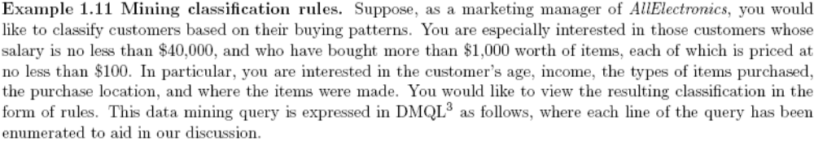
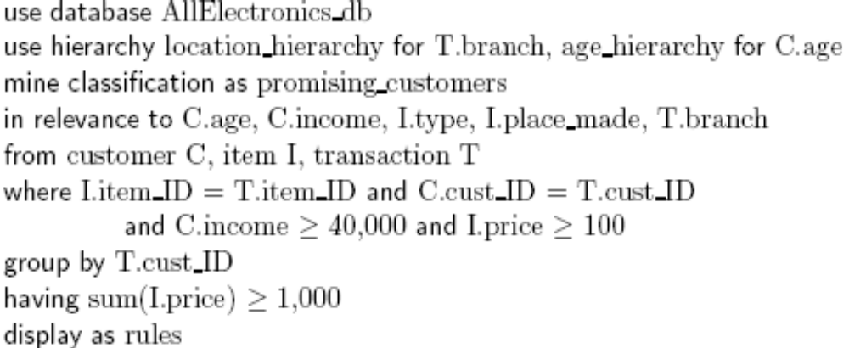
An Example Query in DMQL
Data Mining: Concepts and Techniques

Slide 46
Other Data Mining Languages & Standardization Efforts
Association rule language specifications
  MSQL (Imielinski & Virmani’99)
  MineRule (Meo Psaila and Ceri’96)
  Query flocks based on Datalog syntax (Tsur et al’98)
OLEDB for DM (Microsoft’2000) and recently DMX (Microsoft SQLServer 2005)
  Based on OLE, OLE DB, OLE DB for OLAP, C#
  Integrating DBMS, data warehouse and data mining
DMML (Data Mining Mark-up Language) by DMG (www.dmg.org)
  Providing a platform and process structure for effective data mining
  Emphasizing on deploying data mining technology to solve business problems
Data Mining: Concepts and Techniques

Slide 47
Integration of Data Mining and Data Warehousing
Integration of Data mining systems with DBMS, Data warehouse systems (coupling)
  No coupling- DM system will not utilize any functions of DB or SW system.
  Loose-coupling- DM system will use some facilities of a DB or SW system (fetching data from data repository, performing data mining and storing results in a file or in DB or DW). Better than no coupling
  Semi-tight-coupling- besides linking DM system to DB/DW, efficient implementation of few essential data mining premitives like sorting, indexing, aggregating …
  Tight-coupling- DM system is smoothly integrated into DB/DW. Treated as one functional component of an information system. Highly desirable as it facilitate efficient implementation of data mining functions, high system performance and an integrated information processing environment.
Data Mining: Concepts and Techniques

Slide 48
Coupling Data Mining with DB/DW Systems
No coupling—flat file processing, not recommended
Loose coupling
  Fetching data from DB/DW
Semi-tight coupling—enhanced DM performance
  Provide efficient implement a few data mining primitives in a DB/DW system, e.g., sorting, indexing, aggregation, histogram analysis, multiway join, precomputation of some stat functions
Tight coupling—A uniform information processing environment
  DM is smoothly integrated into a DB/DW system, mining query is optimized based on mining query, indexing, query processing methods, etc.
Data Mining: Concepts and Techniques

Slide 49
Integration of Data Mining and Data Warehousing
On-line analytical mining data
  integration of mining and OLAP technologies
Interactive mining multi-level knowledge
  Necessity of mining knowledge and patterns at different levels of abstraction by drilling/rolling, pivoting, slicing/dicing, etc.
Integration of multiple mining functions
  Characterized classification, first clustering and then association
Data Mining: Concepts and Techniques

Slide 50
Major Issues in Data Mining
Mining methodology
  Mining different kinds of knowledge from diverse data types, e.g., bio, stream, Web
  Performance: efficiency, effectiveness, and scalability
  Pattern evaluation: the interestingness problem
  Incorporation of background knowledge
  Handling noise and incomplete data
  Integration of the discovered knowledge with existing one: knowledge fusion
Performance Issues
  Parallel, distributed and incremental mining methods
  Efficiency and scalability of data mining algorithms
User interaction Issues
  Data mining query languages and ad-hoc mining
  Expression and visualization of data mining results
  Interactive mining of knowledge at multiple levels of abstraction
Data Mining: Concepts and Techniques

Slide 51
Issues relating to the diversity of database types
  Handling of relational and complex types of data
  Mining information from heterogeneous databases and global information systems: Local and widearea computer networks (such as the Internet) connect many sources of data, forming huge, distributed, and heterogeneous databases. The discovery of knowledge from different sources of structured, semistructured, or unstructured data with diverse data semantics poses great challenges to data mining.
Applications and social impacts
  Domain-specific data mining & invisible data mining
  Protection of data security, integrity, and privacy
Data Mining: Concepts and Techniques

Slide 52
Summary
Data mining: Discovering interesting patterns from large amounts of data
A natural evolution of database technology, in great demand, with wide applications
A KDD process includes data cleaning, data integration, data selection, transformation, data mining, pattern evaluation, and knowledge presentation
Mining can be performed in a variety of information repositories
Data mining functionalities: characterization, discrimination, association, classification, clustering, outlier and trend analysis, etc.
Data mining systems and architectures
Major issues in data mining
Data Mining: Concepts and Techniques

Slide 53
A Brief History of Data Mining Society
1989 IJCAI Workshop on Knowledge Discovery in Databases
  Knowledge Discovery in Databases (G. Piatetsky-Shapiro and W. Frawley, 1991)
1991-1994 Workshops on Knowledge Discovery in Databases
  Advances in Knowledge Discovery and Data Mining (U. Fayyad, G. Piatetsky-Shapiro, P. Smyth, and R. Uthurusamy, 1996)
1995-1998 International Conferences on Knowledge Discovery in Databases and Data Mining (KDD’95-98)
  Journal of Data Mining and Knowledge Discovery (1997)
ACM SIGKDD conferences since 1998 and SIGKDD Explorations
More conferences on data mining
  PAKDD (1997), PKDD (1997), SIAM-Data Mining (2001), (IEEE) ICDM (2001), etc.
ACM Transactions on KDD starting in 2007
Data Mining: Concepts and Techniques

Slide 54
Conferences and Journals on Data Mining
KDD Conferences
  ACM SIGKDD Int. Conf. on Knowledge Discovery in Databases and Data Mining (KDD)
  SIAM Data Mining Conf. (SDM)
  (IEEE) Int. Conf. on Data Mining (ICDM)
  Conf. on Principles and practices of Knowledge Discovery and Data Mining (PKDD)
  Pacific-Asia Conf. on Knowledge Discovery and Data Mining (PAKDD)
Other related conferences
  ACM SIGMOD
  VLDB
  (IEEE) ICDE
  WWW, SIGIR
  ICML, CVPR, NIPS
Journals
  Data Mining and Knowledge Discovery (DAMI or DMKD)
  IEEE Trans. On Knowledge and Data Eng. (TKDE)
  KDD Explorations
  ACM Trans. on KDD
Data Mining: Concepts and Techniques

Slide 55
Where to Find References? DBLP, CiteSeer, Google
Data mining and KDD (SIGKDD: CDROM)
  Conferences: ACM-SIGKDD, IEEE-ICDM, SIAM-DM, PKDD, PAKDD, etc.
  Journal: Data Mining and Knowledge Discovery, KDD Explorations, ACM TKDD
Database systems (SIGMOD: ACM SIGMOD Anthology—CD ROM)
  Conferences: ACM-SIGMOD, ACM-PODS, VLDB, IEEE-ICDE, EDBT, ICDT, DASFAA
  Journals: IEEE-TKDE, ACM-TODS/TOIS, JIIS, J. ACM, VLDB J., Info. Sys., etc.
AI & Machine Learning
  Conferences: Machine learning (ML), AAAI, IJCAI, COLT (Learning Theory), CVPR, NIPS, etc.
  Journals: Machine Learning, Artificial Intelligence, Knowledge and Information Systems, IEEE-PAMI, etc.
Web and IR
  Conferences: SIGIR, WWW, CIKM, etc.
  Journals: WWW: Internet and Web Information Systems,
Statistics
  Conferences: Joint Stat. Meeting, etc.
  Journals: Annals of statistics, etc.
Visualization
  Conference proceedings: CHI, ACM-SIGGraph, etc.
  Journals: IEEE Trans. visualization and computer graphics, etc.
Data Mining: Concepts and Techniques

Slide 56
Recommended Reference Books
S. Chakrabarti. Mining the Web: Statistical Analysis of Hypertex and Semi-Structured Data. Morgan Kaufmann, 2002
R. O. Duda, P. E. Hart, and D. G. Stork, Pattern Classification, 2ed., Wiley-Interscience, 2000
T. Dasu and T. Johnson. Exploratory Data Mining and Data Cleaning. John Wiley & Sons, 2003
U. M. Fayyad, G. Piatetsky-Shapiro, P. Smyth, and R. Uthurusamy. Advances in Knowledge Discovery and Data Mining. AAAI/MIT Press, 1996
U. Fayyad, G. Grinstein, and A. Wierse, Information Visualization in Data Mining and Knowledge Discovery, Morgan Kaufmann, 2001
J. Han and M. Kamber. Data Mining: Concepts and Techniques. Morgan Kaufmann, 2nd ed., 2006
D. J. Hand, H. Mannila, and P. Smyth, Principles of Data Mining, MIT Press, 2001
T. Hastie, R. Tibshirani, and J. Friedman, The Elements of Statistical Learning: Data Mining, Inference, and Prediction, Springer-Verlag, 2001
T. M. Mitchell, Machine Learning, McGraw Hill, 1997
G. Piatetsky-Shapiro and W. J. Frawley. Knowledge Discovery in Databases. AAAI/MIT Press, 1991
P.-N. Tan, M. Steinbach and V. Kumar, Introduction to Data Mining, Wiley, 2005
S. M. Weiss and N. Indurkhya, Predictive Data Mining, Morgan Kaufmann, 1998
I. H. Witten and E. Frank, Data Mining: Practical Machine Learning Tools and Techniques with Java Implementations, Morgan Kaufmann, 2nd ed. 2005
Data Mining: Concepts and Techniques

Slide 57
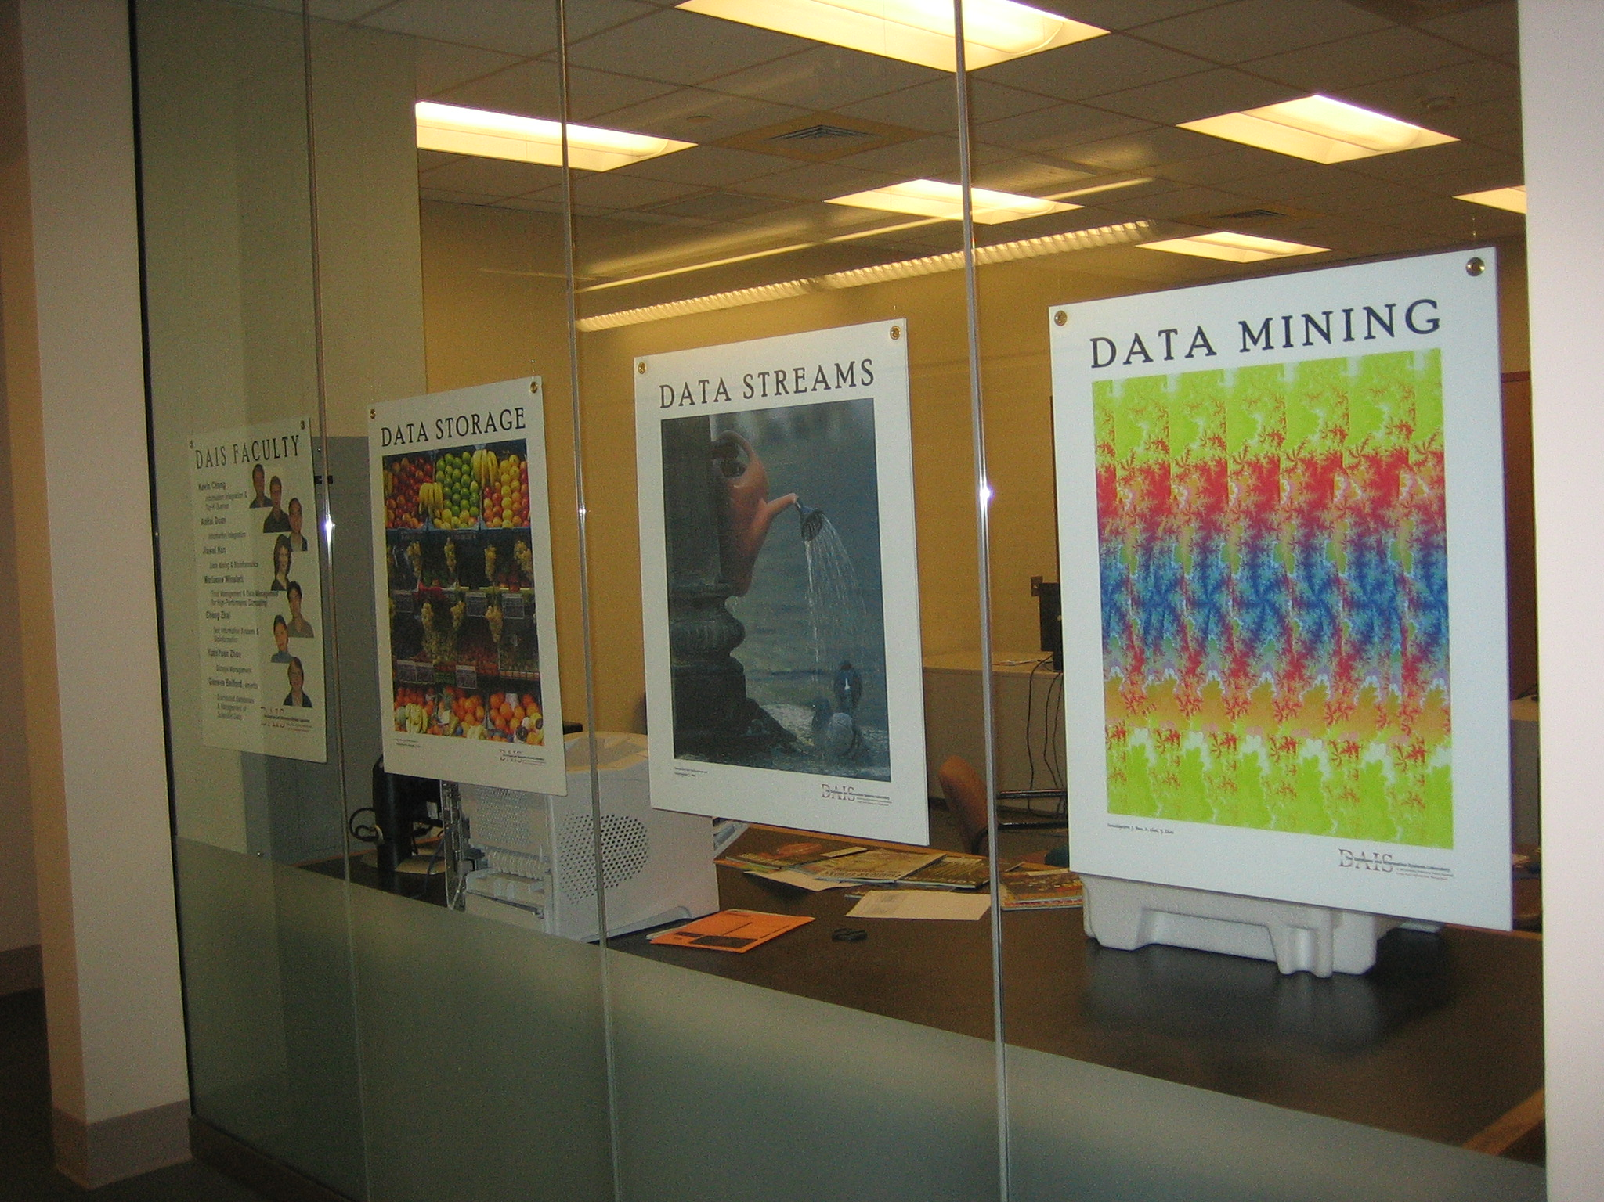
Data Mining: Concepts and Techniques

